Slide 1

MSA PROJECT ML1
DEV TRIPATHI
PG-DSBA FEB21 G-12

Slide 2
Contents
Problem statement
About the dataset
Visualizations and Inferences
RFM analysis
RFM results and Customer Segment description

Slide 3
Problem Statement
An automobile parts manufacturing company has collected data of transactions for 3 years. They do not have any in-house data science team, thus they have hired us as their consultant. Our job is to use our magical data science skills to provide them with suitable insights about their data and their customers.

Slide 4

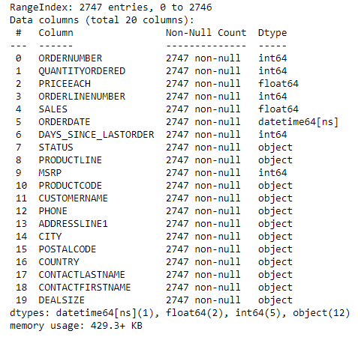
About the Dataset:
The dataset contains 20 columns and 2747 rows.
Most of the features are ‘object’ data type.
ORDERDATE feature is a datetime variable which was used to get insights over a particular duration.
There are no null entries present in the dataset. Hence any kind of imputation wasn’t required
Although for this analysis the datatype of ORDERNUMBER and ORDERLINENUMBER wasn’t altered. But for any further analysis, the datatype of these variables should be changed to ‘object’.
There is one assumption made for the analysis that the analysis was performed on 01/06/2020. Hence, DAYSFROMLASTORDER were calculated based on this date.

Slide 5
Visualizations and Inferences

Slide 6
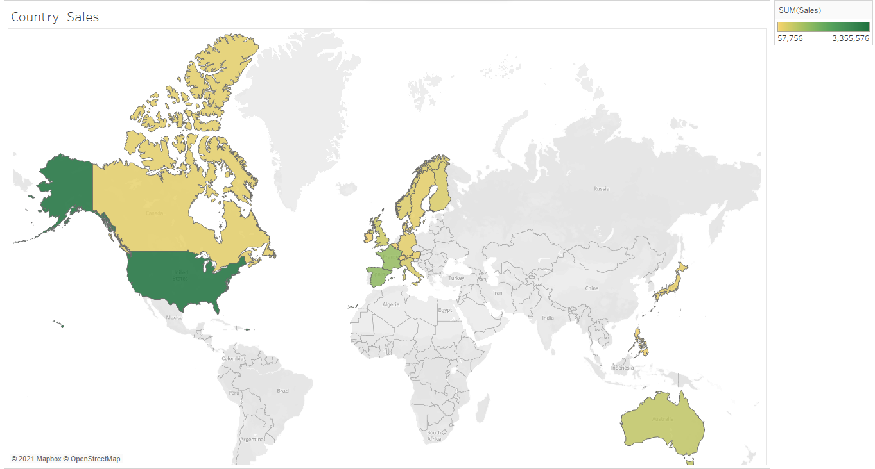
Total Sales across Countries:
For USA, the sales are highest.
Seems like most of the sales is concentrated in USA only
European countries like France and Spain are having the second highest sales

Slide 7
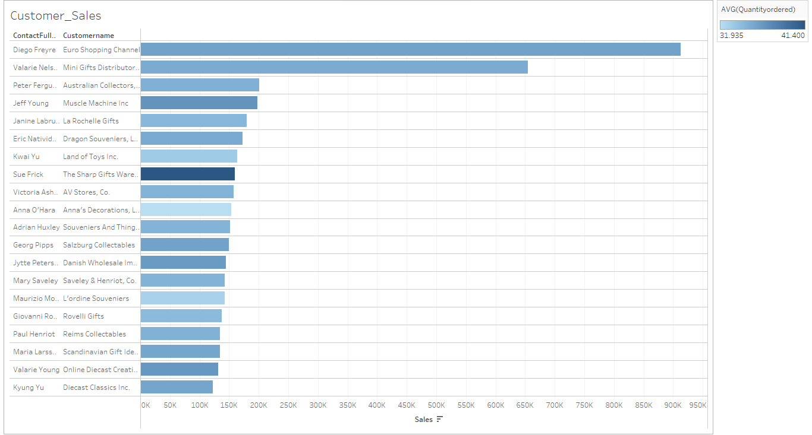
Top 20 Customers based on total Sales ( where intensity of color showing the avg. quantity ordered by customers)
Euro Shopping Channel and Mini Gift Distributors are having significantly higher sales than other customers
Among these customers the Sharp Gifts Warehouse is having highest value of avg. quantity ordered

Slide 8
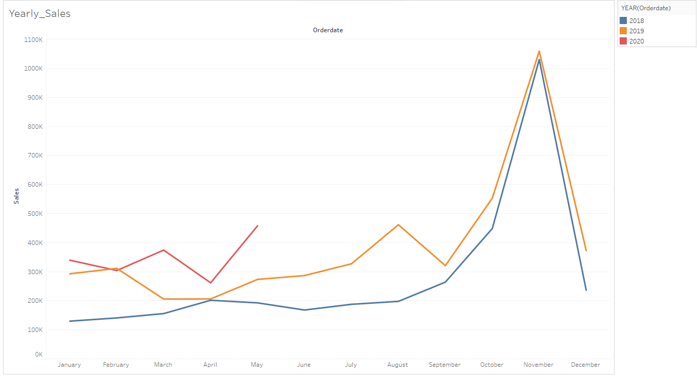
Total Sales over the Years:
Sales seems to be rising over the span of the data available.
Each year there is a considerable spike in the Sales from September to November
After this spike the Sales again goes down again
By the looks of it, the company was doing good in year 2020 so far.

Slide 9
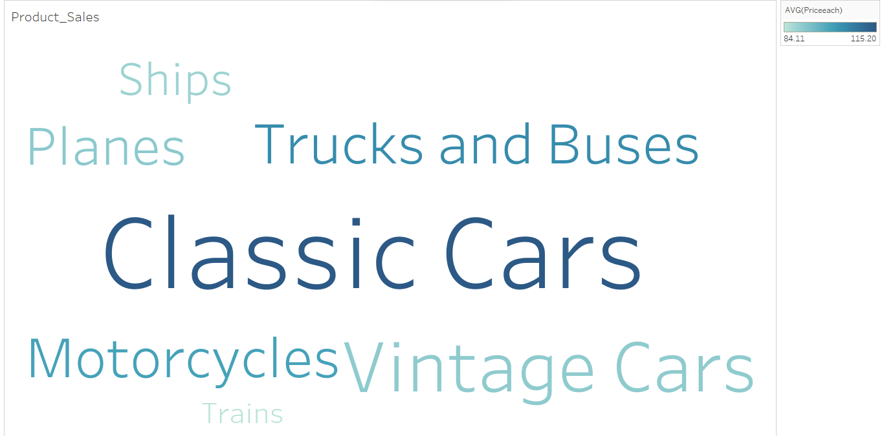
Top performing Product-lines based on Sales (where color is showing the Avg. price of each unit)
Classic cars is having most sales among all the product-lines
Trains and ships are having least contribution in total sales
Classic cars are also having highest Average price per unit

Slide 10
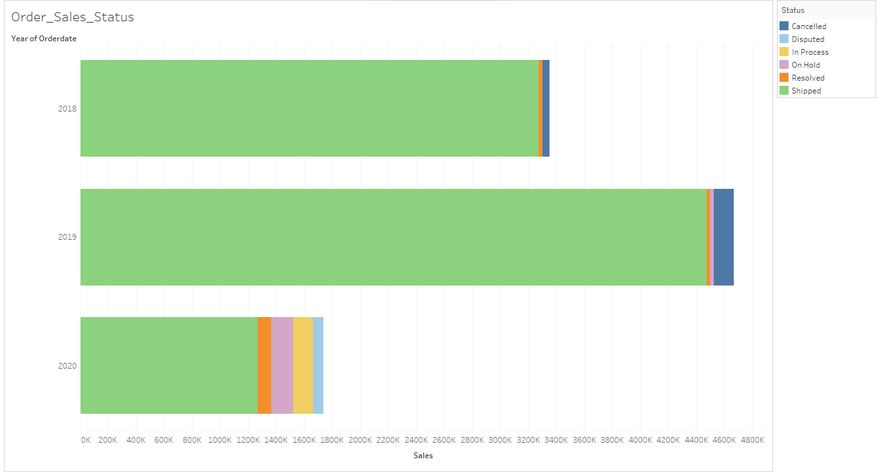
Order Status and Sales over the years:
For each year, most of the sales is for the orders having status as shipped
For year 2020, some of the orders are still in progress or on hold.
For year 2019 the number of orders cancelled are higher than 2018. Company can dig deeper for the reason why this happened.

Slide 11
RFM Analysis and Segmentation

Slide 12
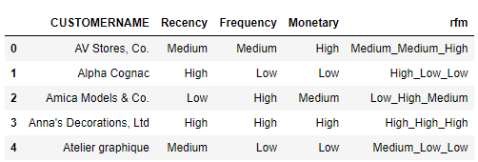
What is RFM?
RFM is a segmentation technique that gives us a measure of the loyalty of the customer. Generally it is refreshed at least once in a quarter as there movements across segments in shorter time frames.
Sample of RFM scores:

Slide 13
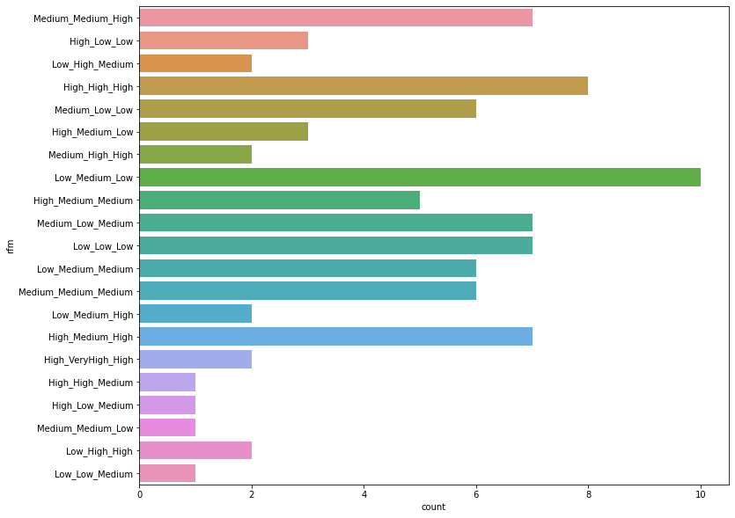
Count plot for
RFM scores
Customers with low recency, medium frequency and low monetary value are highest in number.
There are plenty of customers who are having high recency and medium to high frequency which is a good sign for business

Slide 14
Segmentation Based on RFM scores
Total 4 segments were created based on RFM analysis:
Segment 1 (Best Customers): Customers who are having high to medium recency and their frequency and monetary scores are also high. (>=2 High + No low + High/Medium Recency)
Segment 2 (Loyal Customers): Customers who are having high to medium recency and one of frequency and monetary scores is medium. (>=2 Medium + No low + High/Medium Recency)
Segment 3 (Non frequent and Low profit Customers): Customers who are having high to medium recency and low to medium frequency/monetary scores. (High/medium recency + >=1 low)
Segment 4 (Customers who haven’t made a purchase in while): This is probably the most important category from business perspective. The customers in this group are having low recency. Meaning they have not made a purchase in a long time.

Slide 15
Best Customers identified based on RFM analysis:
CUSTOMERNAME | Recency | Frequency | Monetary | rfm | Segment
Euro Shopping Channel | High | VeryHigh | High | High_VeryHigh_High | 1
Mini Gifts Distributors Ltd. | High | VeryHigh | High | High_VeryHigh_High | 1
Anna's Decorations, Ltd | High | High | High | High_High_High | 1
Diecast Classics Inc. | High | High | High | High_High_High | 1
Handji Gifts& Co | High | High | High | High_High_High | 1
Loyal Customers identified based on RFM analysis:
CUSTOMERNAME | Recency | Frequency | Monetary | rfm | Segment
AV Stores, Co. | Medium | Medium | High | Medium_Medium_High | 2
Baane Mini Imports | Medium | Medium | High | Medium_Medium_High | 2
Land of Toys Inc. | Medium | Medium | High | Medium_Medium_High | 2
Online Diecast Creations Co. | Medium | Medium | High | Medium_Medium_High | 2
Rovelli Gifts | Medium | Medium | High | Medium_Medium_High | 2

Slide 16
Customers identified who are at verge of churning (based on RFM analysis):
CUSTOMERNAME | Recency | Frequency | Monetary | rfm | Segment
Saveley & Henriot, Co. | Low | High | High | Low_High_High | 4
Vida Sport, Ltd | Low | High | High | Low_High_High | 4
Amica Models & Co. | Low | High | Medium | Low_High_Medium | 4
Marta's Replicas Co. | Low | High | Medium | Low_High_Medium | 4
Corrida Auto Replicas, Ltd | Low | Medium | High | Low_Medium_High | 4
Lost Customers identified based on RFM analysis:
CUSTOMERNAME | Recency | Frequency | Monetary | rfm | Segment
CAF Imports | Low | Low | Low | Low_Low_Low | 4
Cambridge Collectables Co. | Low | Low | Low | Low_Low_Low | 4
Double Decker Gift Stores, Ltd | Low | Low | Low | Low_Low_Low | 4
Iberia Gift Imports, Corp. | Low | Low | Low | Low_Low_Low | 4
Microscale Inc. | Low | Low | Low | Low_Low_Low | 4

Slide 17
Assumptions
For frequency and recency calculations it was assumed that the analysis was performed on 01/06/2021 (as the last order placed was on 31/05/2021)
For segmentation of recency, three classes has been created i.e. High, Medium and Low which contain fairly equal numbers of data point.
For segmentation of “monetary” values also, three classes has been created i.e. High, Medium and Low which contain fairly equal numbers of data point.
Frequency | Transactions per month
VeryHigh | >6
High | >2
Medium | 1
Low | 0
Similarly, for segmentation of frequency, four classes have been created (i.e. VeryHigh, High, Medium and Low). But in case of frequency the corresponding values were assumed integer only:

Slide 18
Tools used for this analysis
Python: Basic libraries like NumPy, Pandas, Matplotlib and seaborn were used for manipulations and some visualizations.
Tableau: For more intuitive and good visualizations tableau was used.
Lastly, Segmentations were done simply in the Excel.
For any further information, please refer to files attached with this presentation.

Slide 19
Thank you!

